Slide 1
Logistic Regression

Slide 2
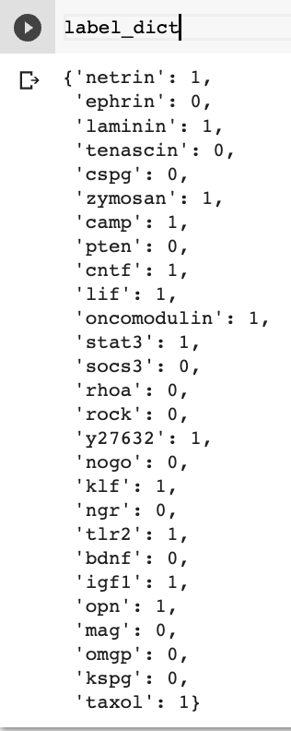
Acquire positive and negative sentences by using manually labeled molecules

Slide 3
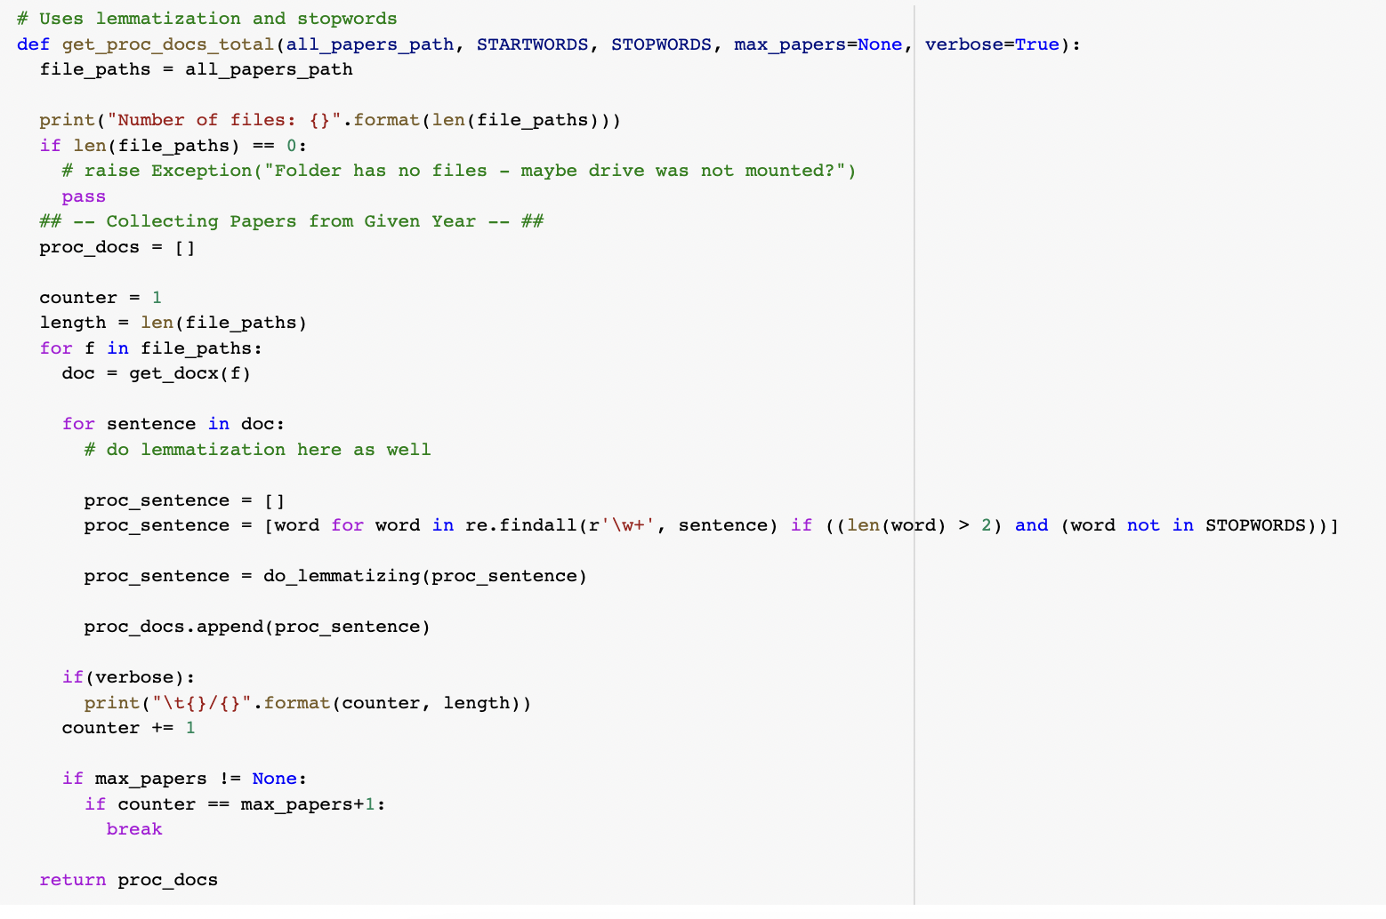
Pre-process all the sentences using lemmatization and removal of stop words

Slide 4
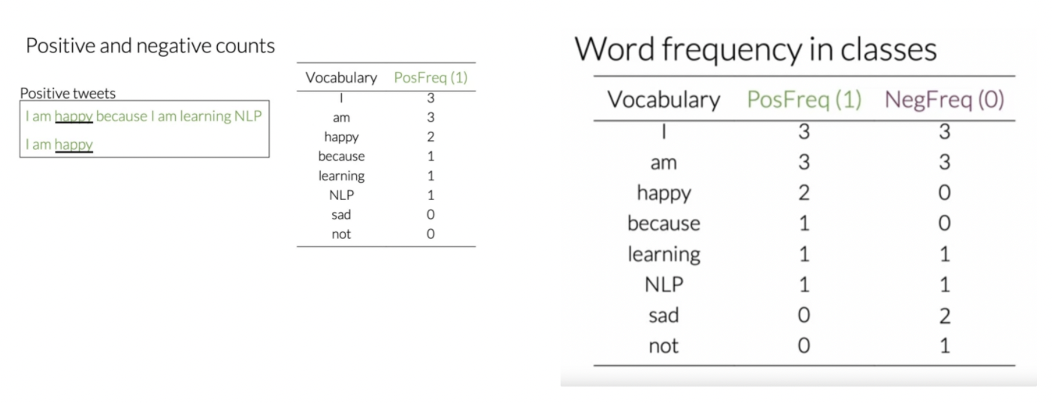
Example of frequency table

Slide 5
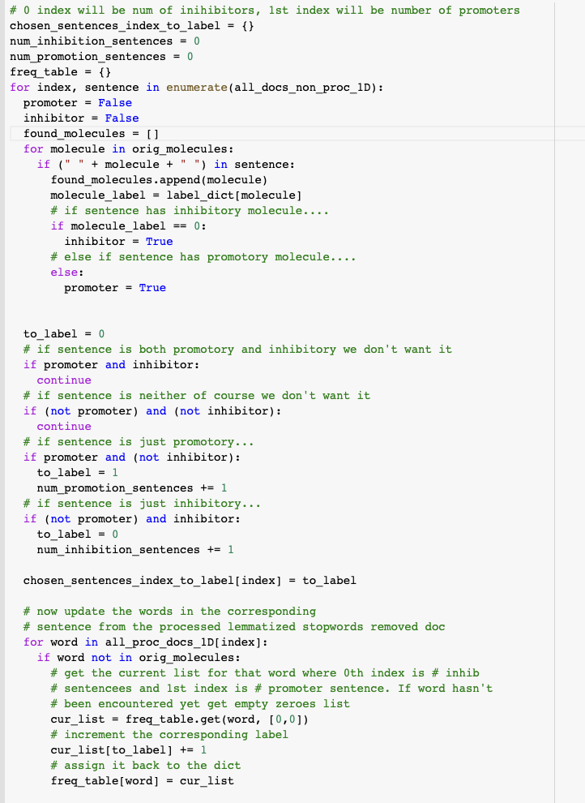
Go through all sentences and label as positive or negative using pre-labeled molecules. During this time you can also create a frequency table

Slide 6
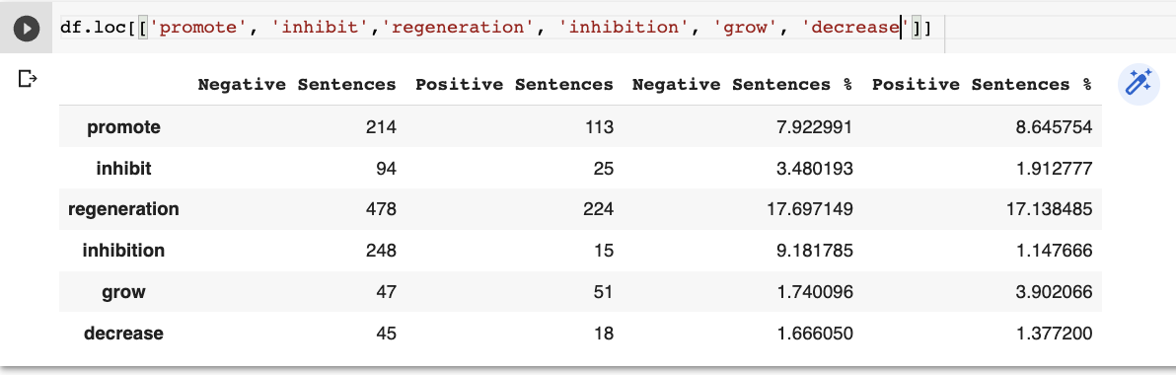
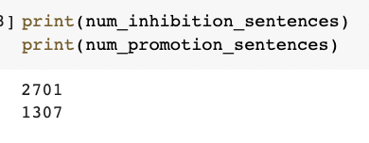
Note that I created a % column because the negative and positive sentences were of different length

Slide 7
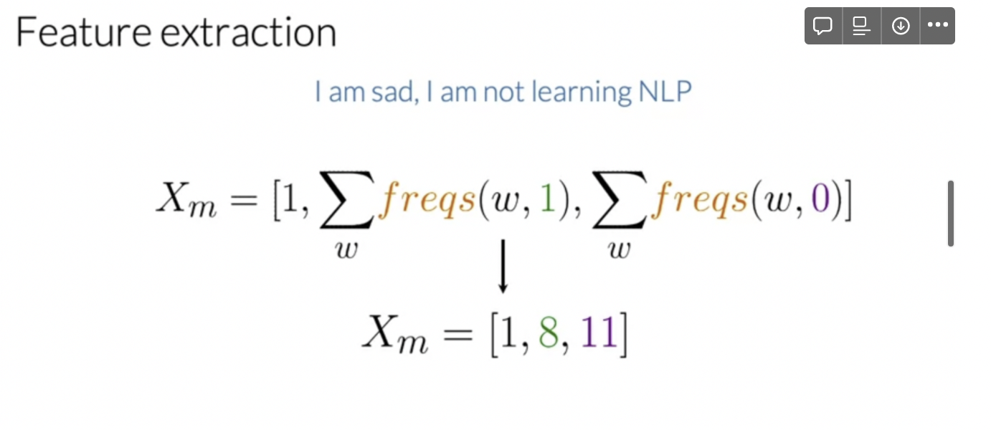
Now we have to convert each sentence into a vector using the frequency table. We simply sum up the frequencies for the positive and negative class of each words. This way we can represent a sentence as a 2D vector (3D here because of the bias term) and then plot it and train it with logistic regression

Slide 8
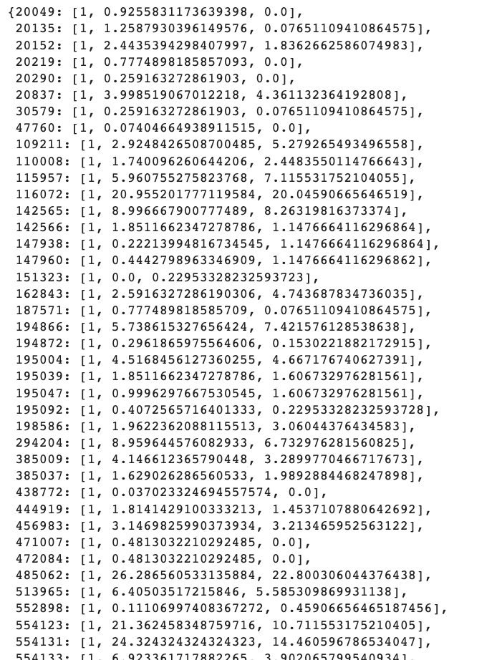
Here the keys are indexes of the sentence and you can see their vector representation

Slide 9
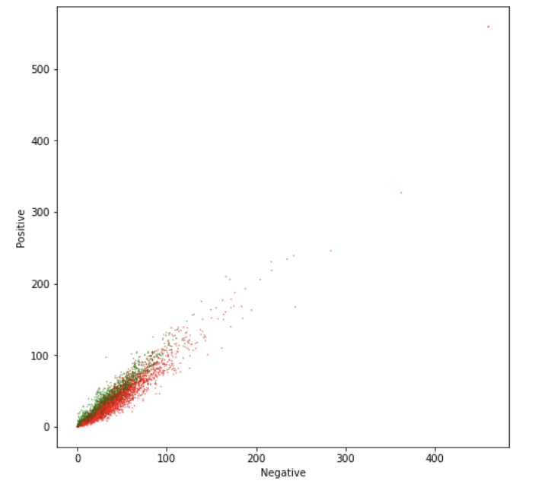
This clearly shows us that the positive and negative sentences can be separated using a logistic regression model

Slide 10
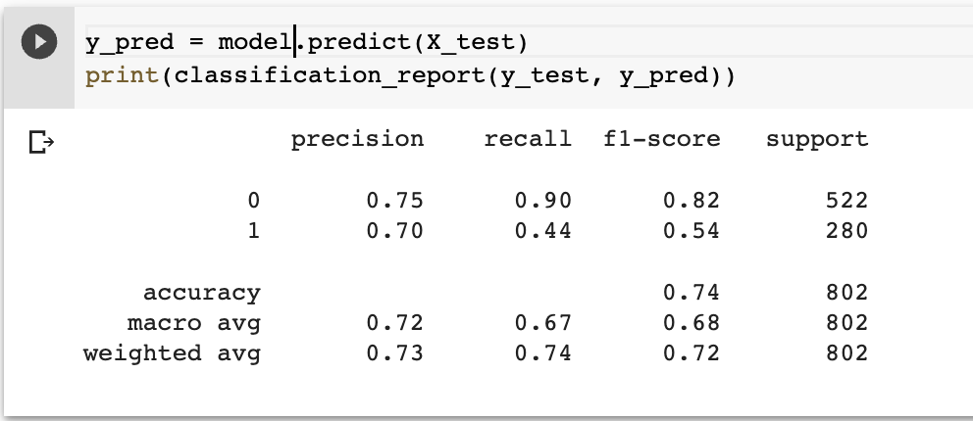
Training the logistic regression model after a 20% train test split gives the following results. Pretty good for inhibition but not so good for promotion which makes sense due to how much more negative sentences there are than positive sentences

Slide 11
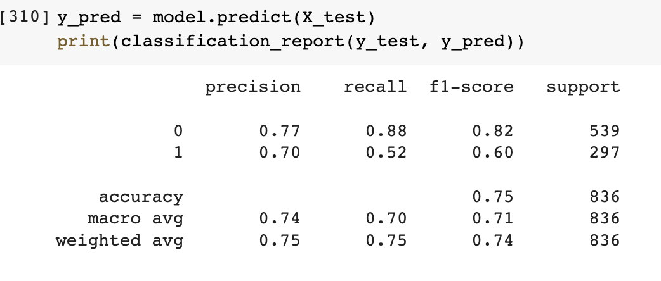
Adding 6 extra promoters to the samples seemed to help a lot

Slide 12
Naive-Bayes

Slide 13
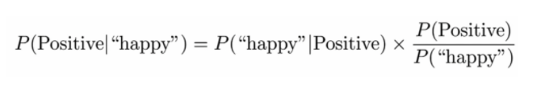

Slide 14
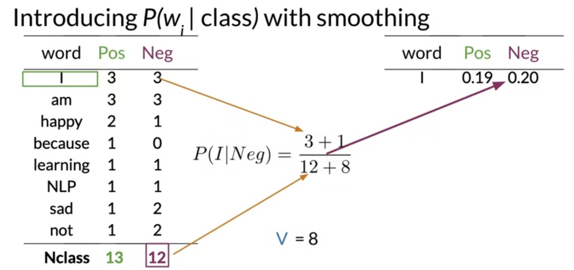

Slide 15
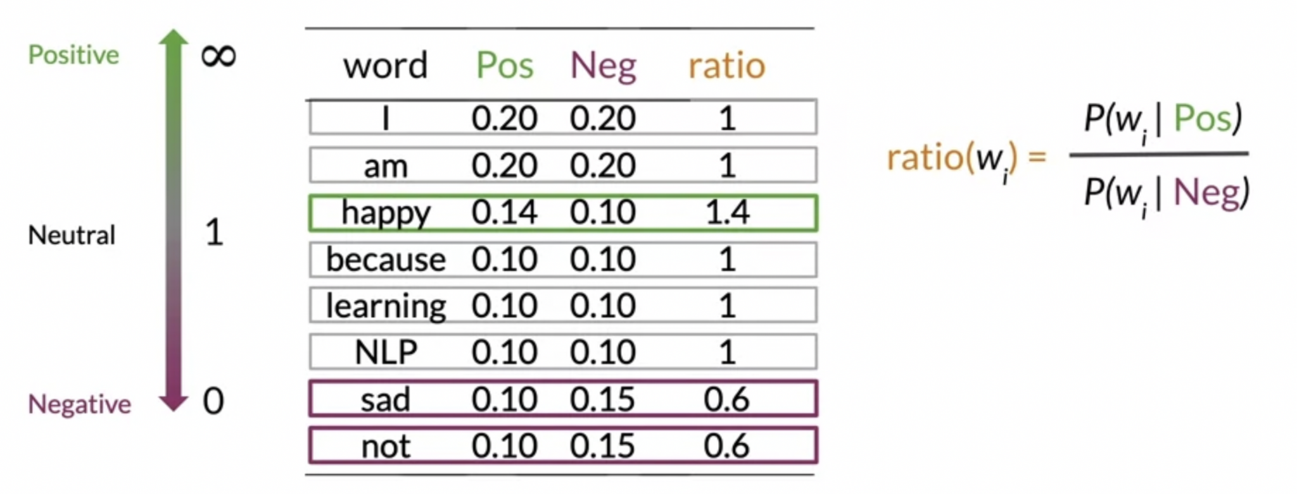

Slide 16
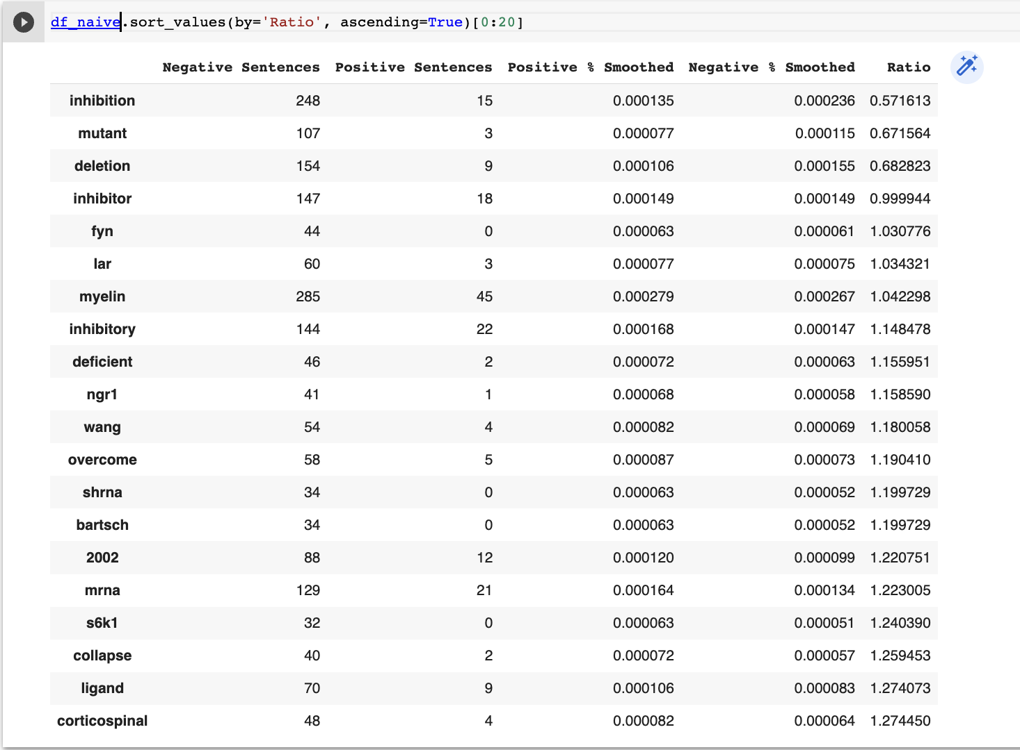
Note: ratio was done by doing positive sentences + 1 / negative sentences + 1
Some interesting results for differentiating negative sentences from positive like inhibition, mutant, deletion, inhibitor, myelin, inhibitory, deficient, overcome, collapse

Slide 17
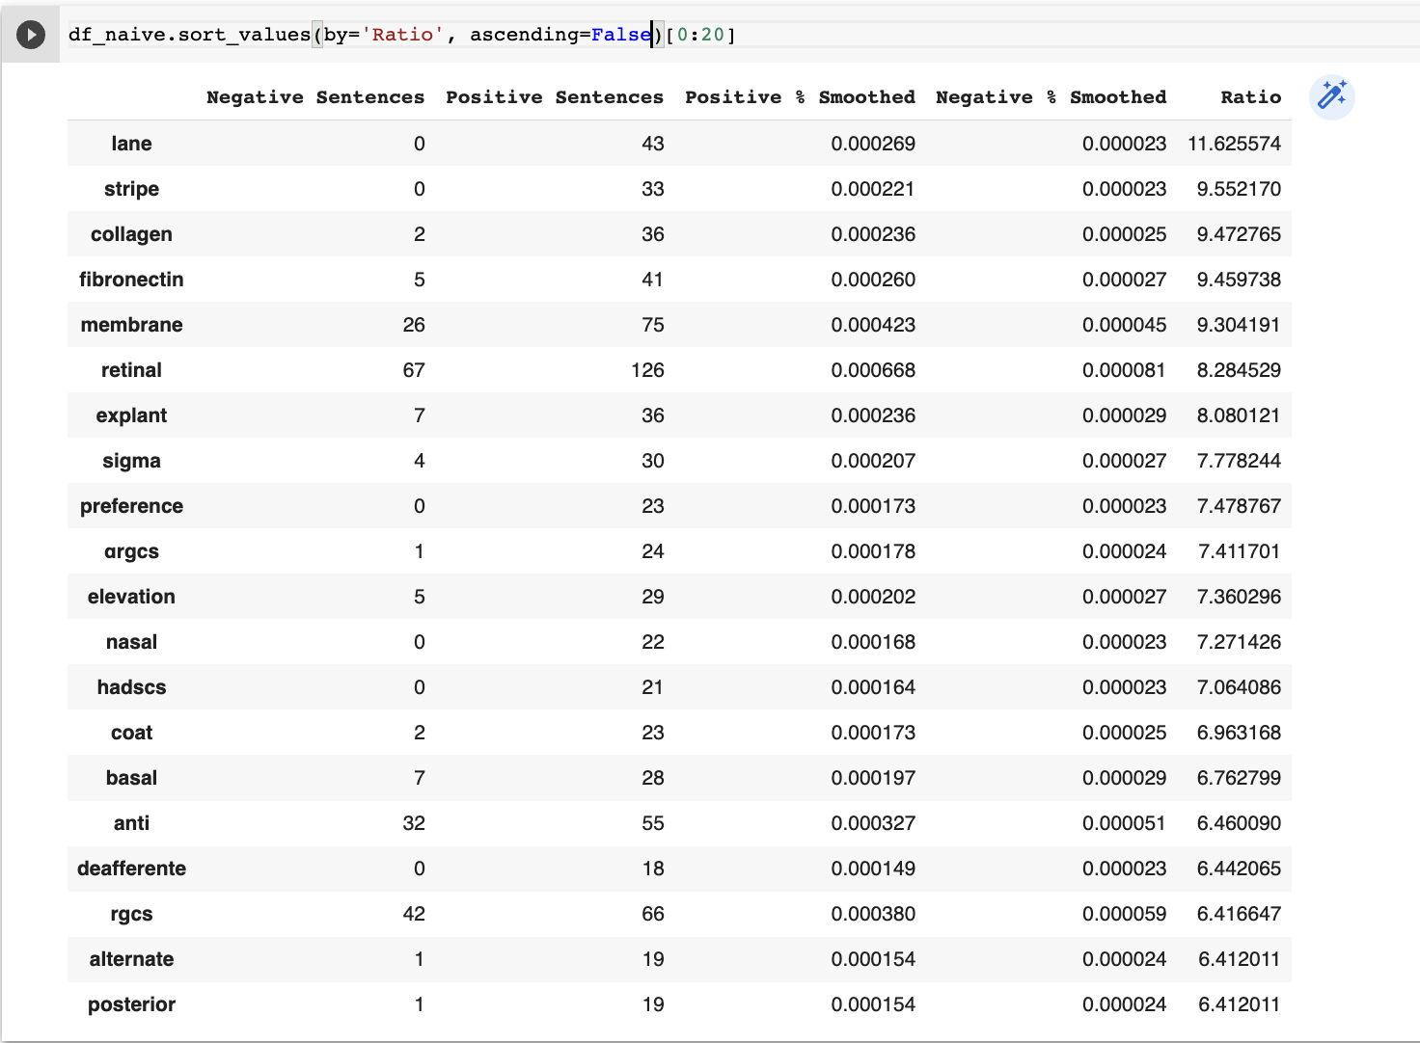
Note: ratio was done by doing positive sentences + 1 / negative sentences + 1
Nothing super striking for differentiating positive from negative

Slide 18
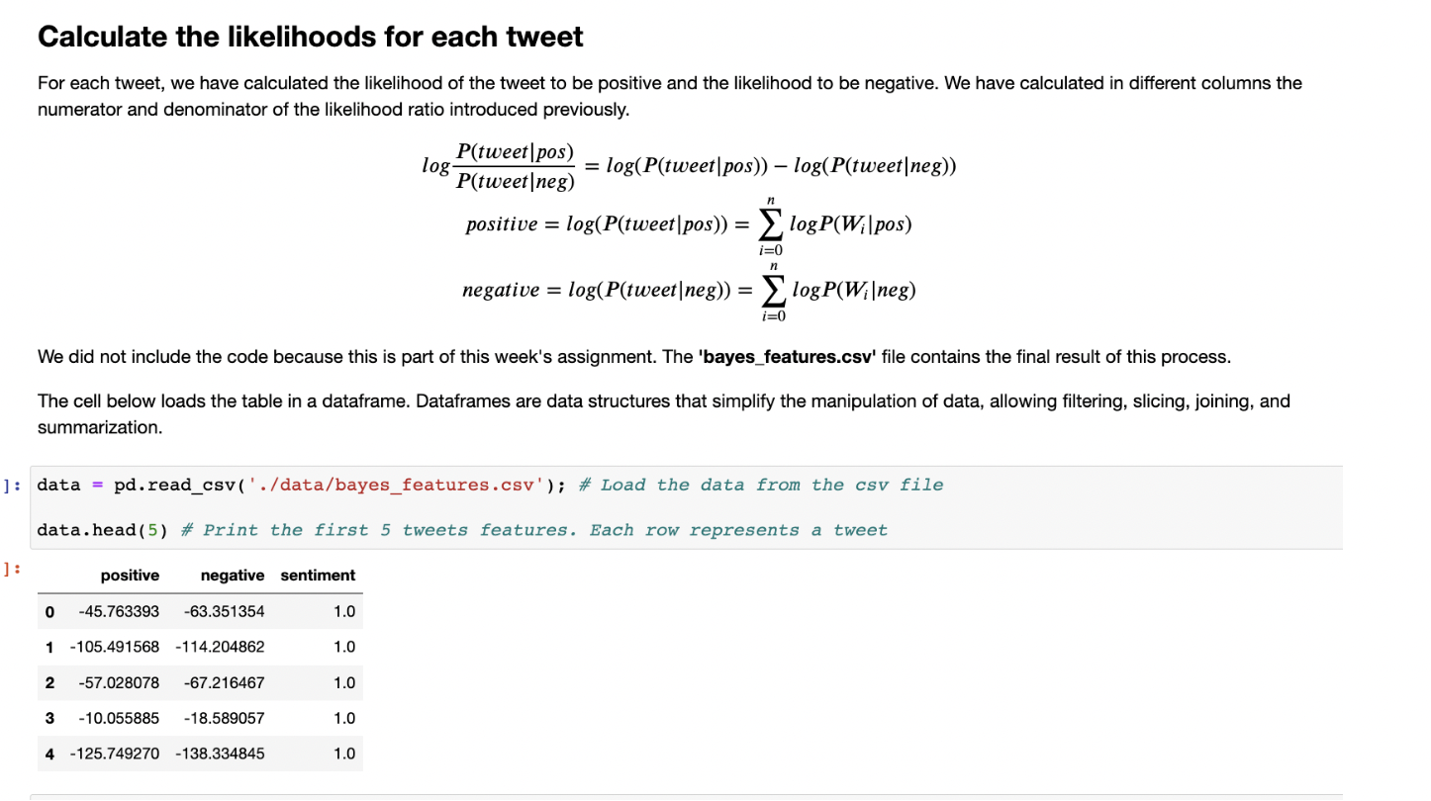

Slide 19
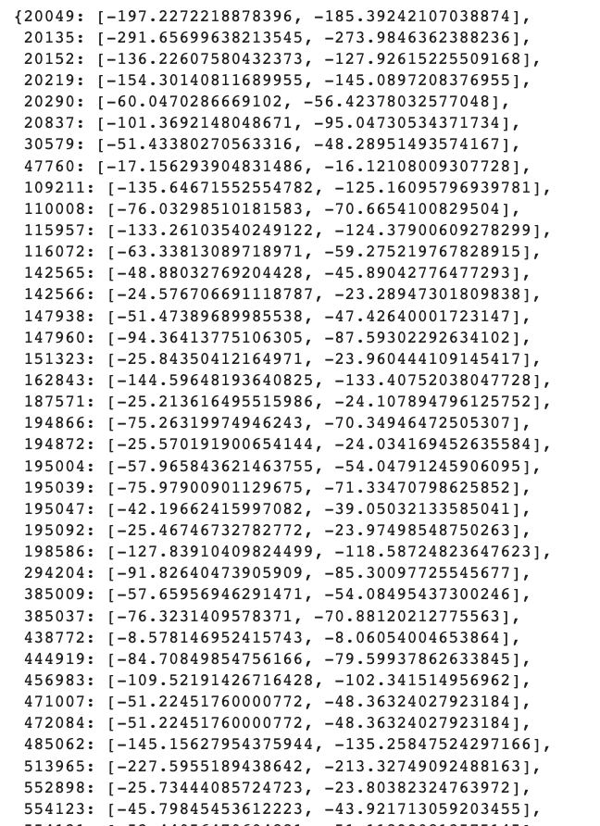
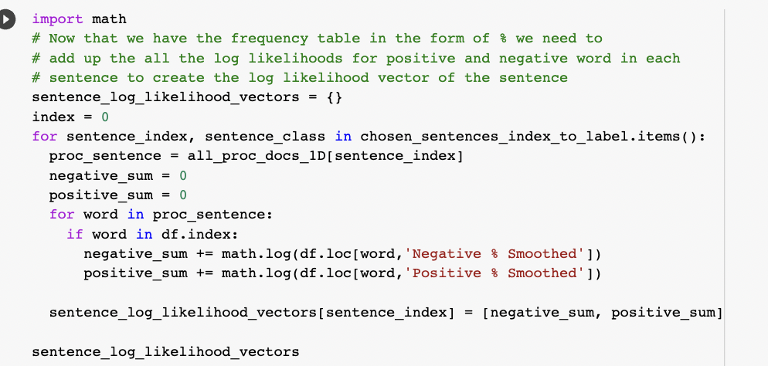
Now we can use the smoothed positive and negative samples frequencies to get a 2D vector representation of each sentence by taking sum of the log of those smoothed for positive and negative to map each dimension

Slide 20
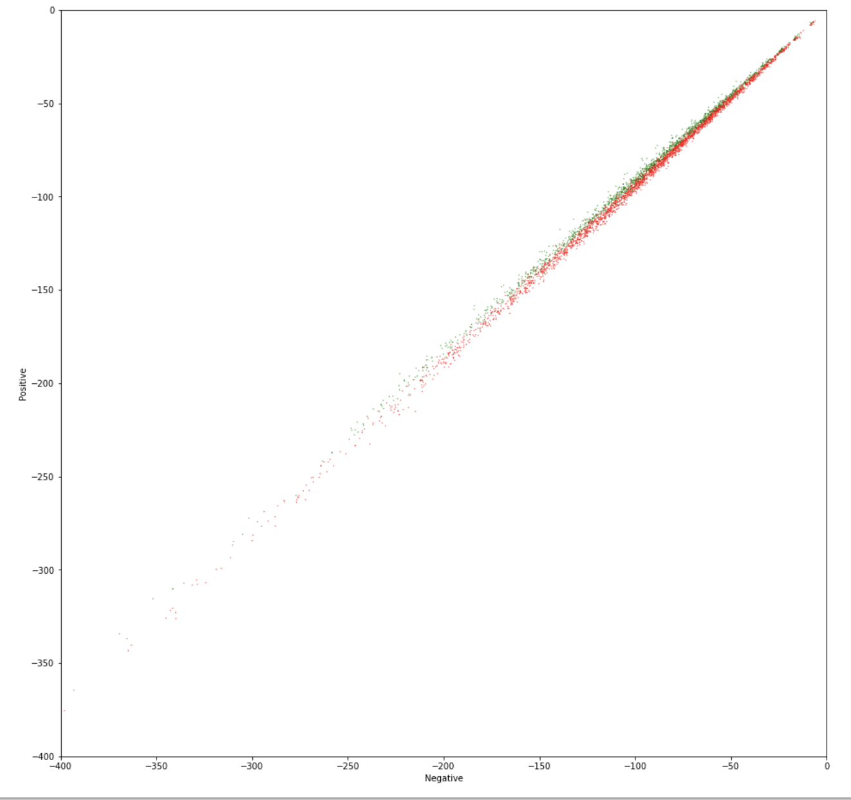
Plotting the vector representations we can see that there is a distinction between positive and negative sentences

Slide 21
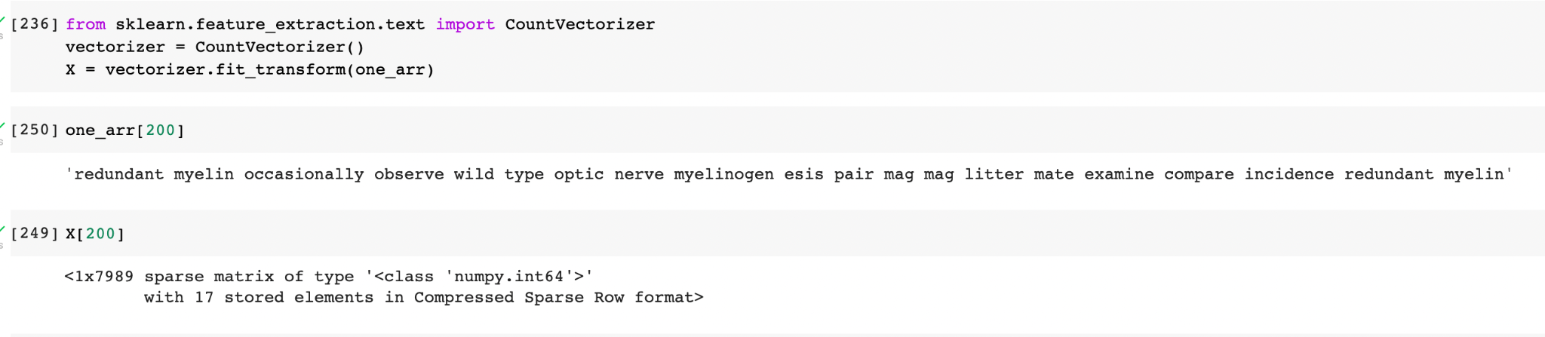
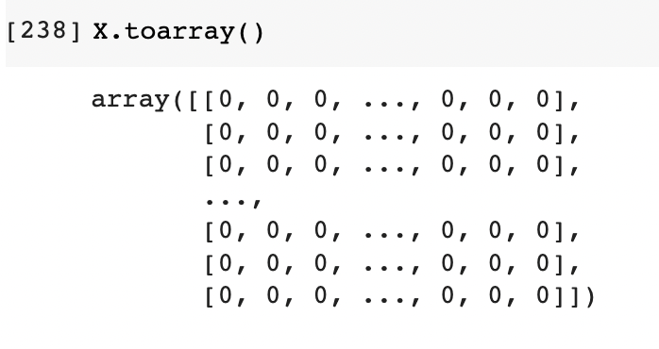
Create a count matrix from our data and use it for our features. We already have the labels for each sentence from before and we use that as our targets. Note that the count matrix is represented as a sparse array.

Slide 22
Naive-Bayes
With More Positive Sentences

Slide 23
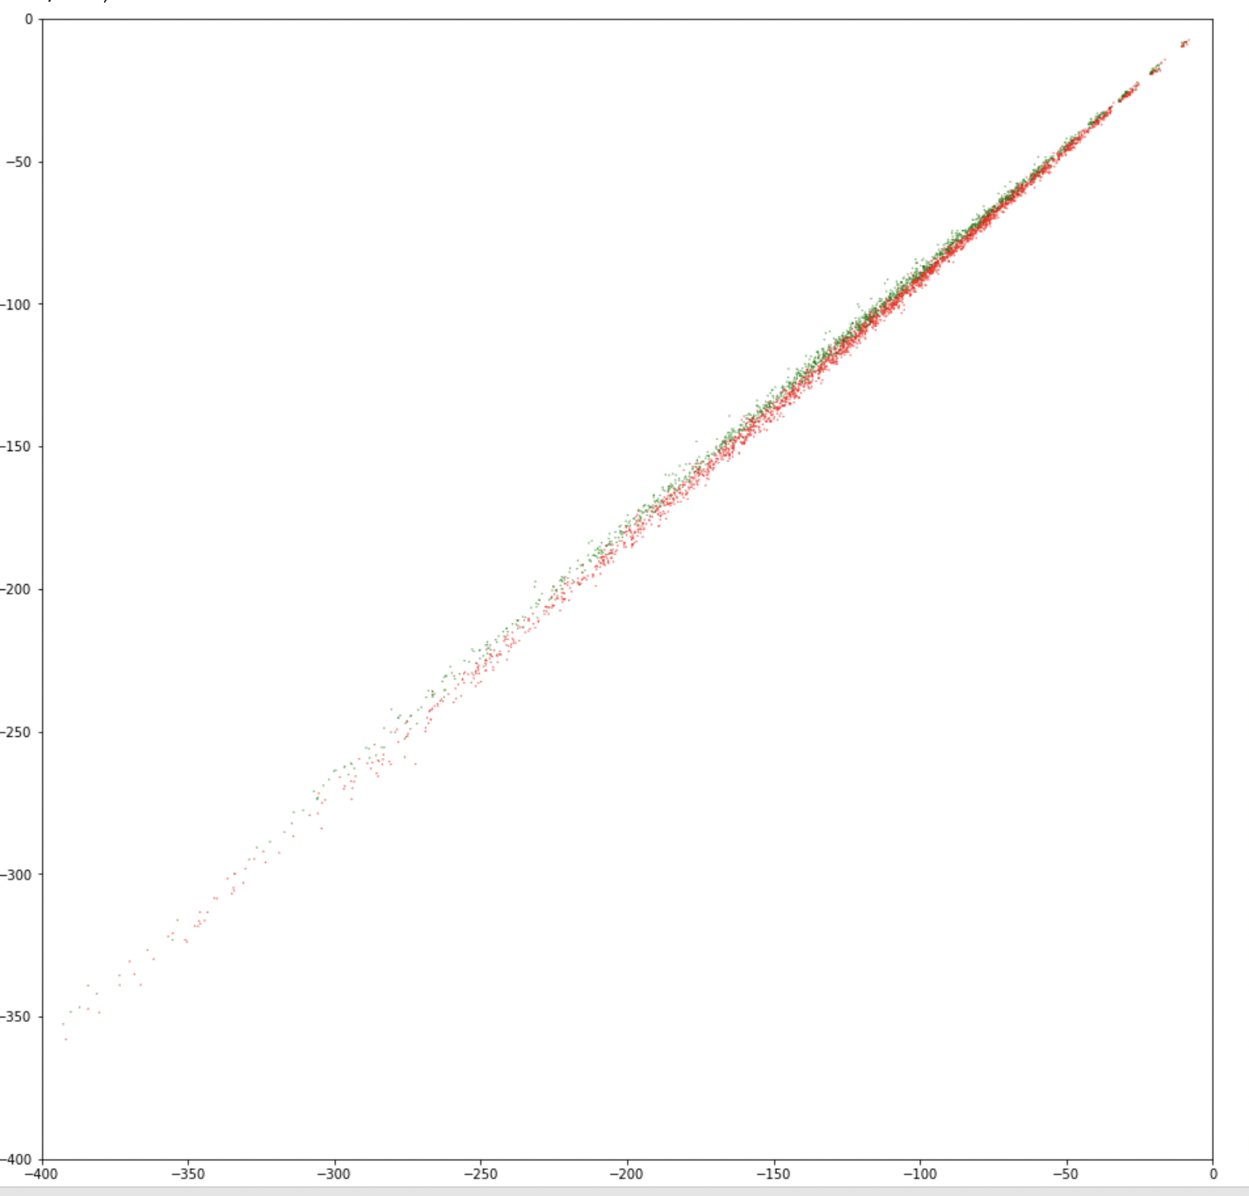
Similar to previous result

Slide 24
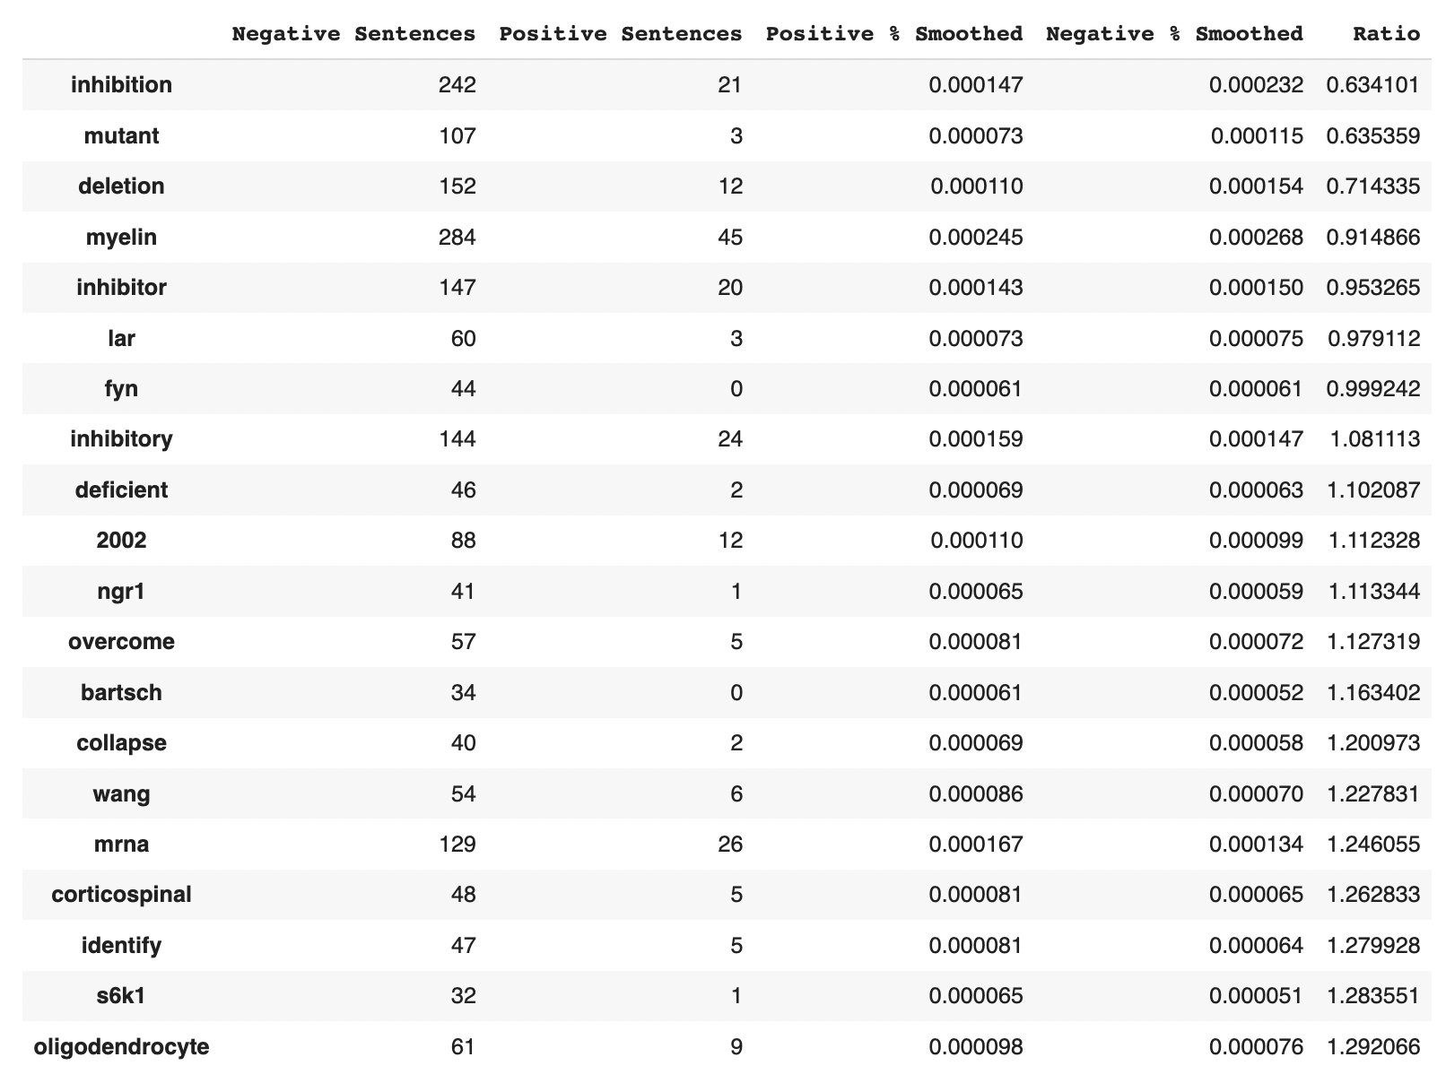
Note: ratio was done by doing positive sentences + 1 / negative sentences + 1
Found some additional interesting ones such as lar, ngr1, overcome, collapse, mrna, and oligodendrocyte

Slide 25
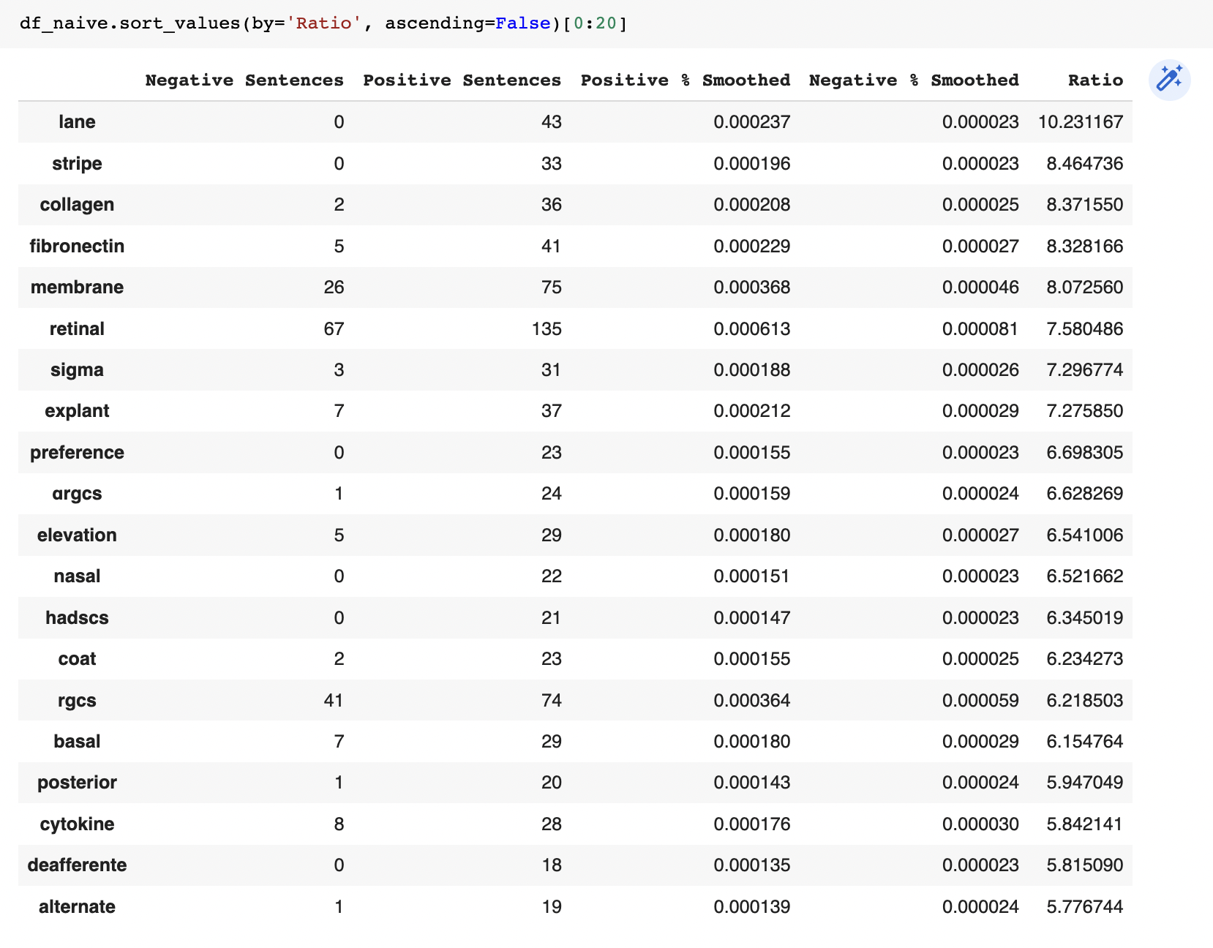
Note: ratio was done by doing positive sentences + 1 / negative sentences + 1
Still nothing interesting with 6 extra promoters

Slide 26
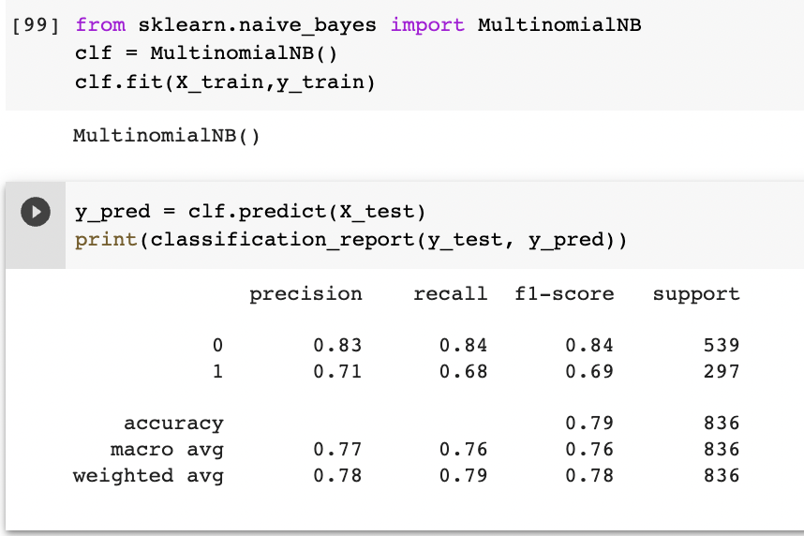
Use multinomial naive-bayes to predict from the count matrix and target
6 extra promoters helped a lot

Slide 27
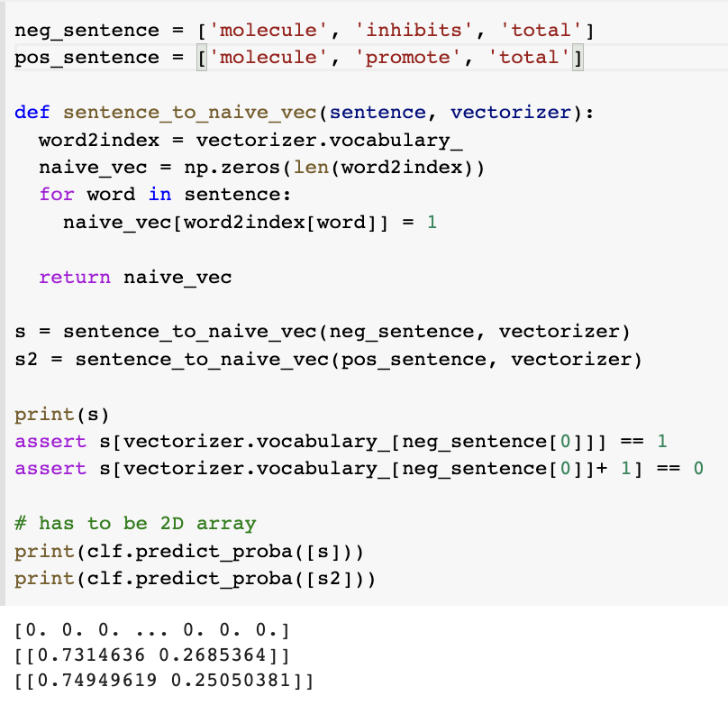
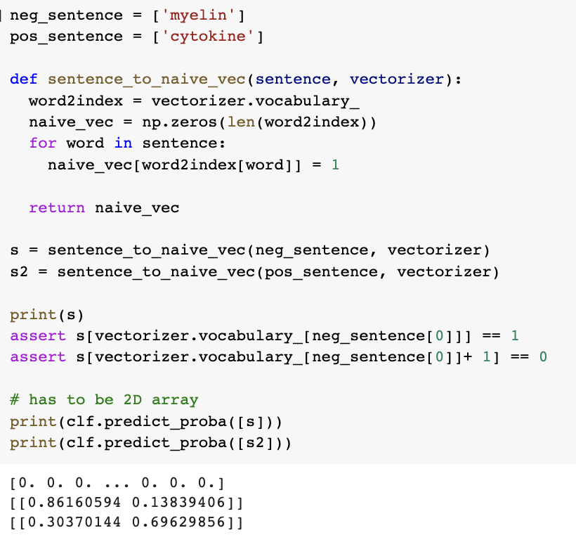
Manual predictions not super great
But works on high ratio words from previous tables

Slide 28
Simple Neural Network

Slide 29
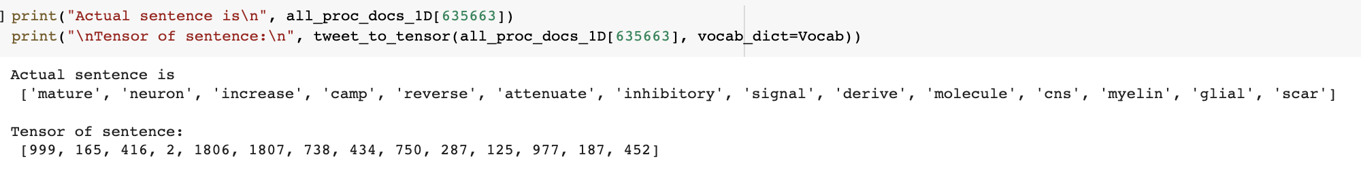
First had to create tensor representation of processed (lemmatized and stopwords removed) sentences.
This was done by representing each word as an index and then combining words into array to represent a sentence

Slide 30
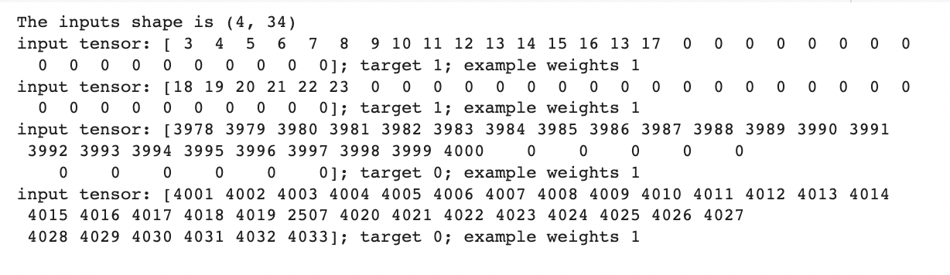
A batch of 4 is shown above
The longest sentence in a batch was used to determine padding for the other sentences in a batch to ensure constant size between sentences
Each batch had equal amount of positive sentences and negative sentences. All weights were set to 1.

Slide 31
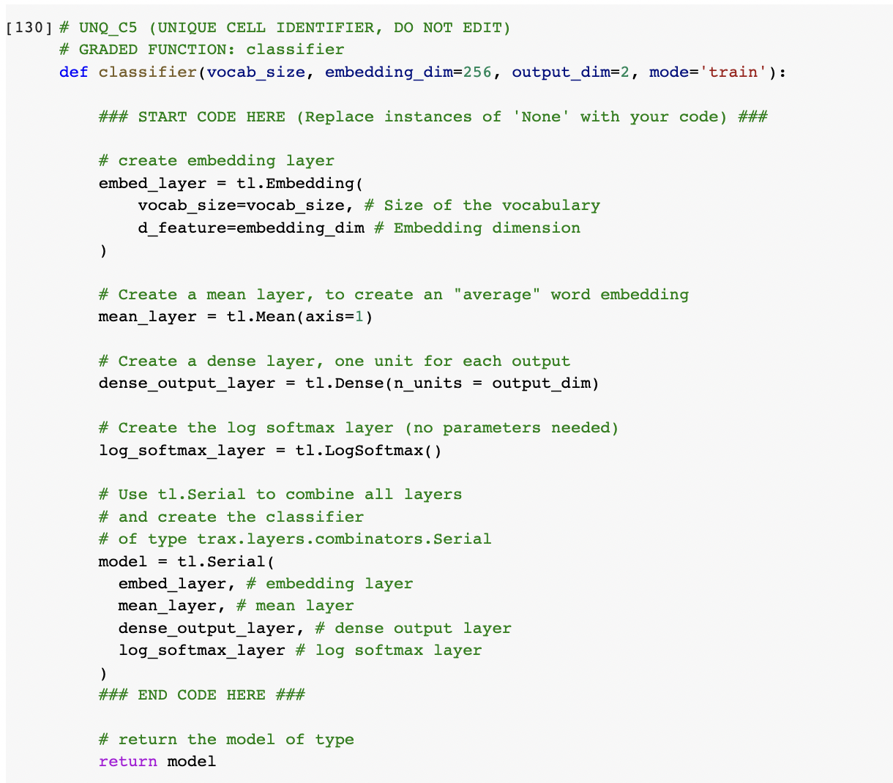
The neural network had 4 layers
Embed Layer: transformed (batch size, vocab size, longest_sentence_size) into a vector of (batch size, vocab size embedding_dimension)
These can later be extracted to get word embeddings
Mean Layer: Took this embedding layer and took means column-wise to get vector of (batch size, 256)
This is to decrease parameters of future layers
Dense layer: Wx + b where x is vector from mean layer. W and b are both trainable weights
Log Softmax layer: Converts vector to probability vector with dimension batch size, 2 to generate positive chance in first column and negative chance in second column for each sentence

Slide 32
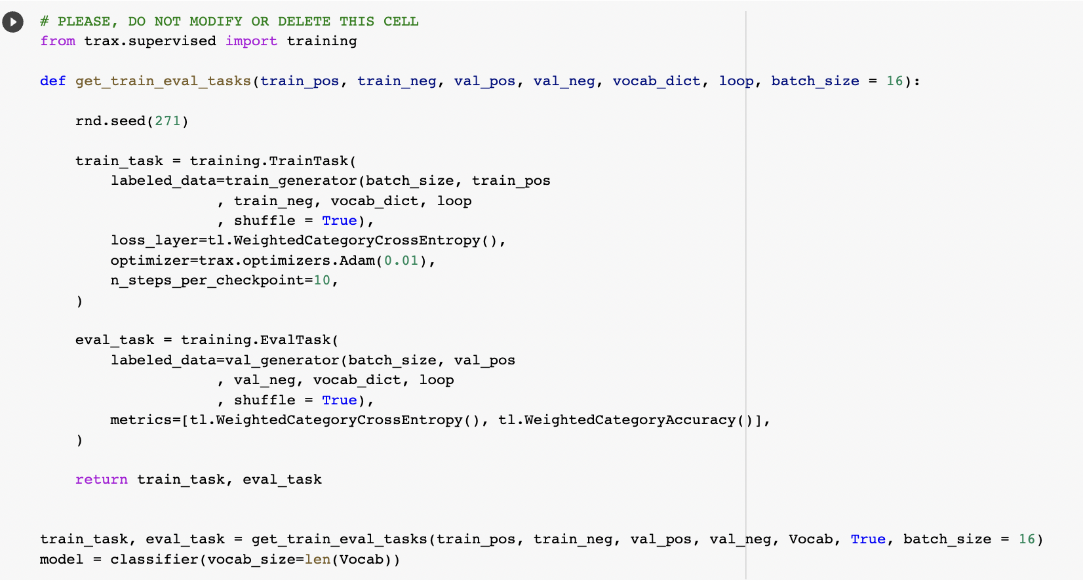
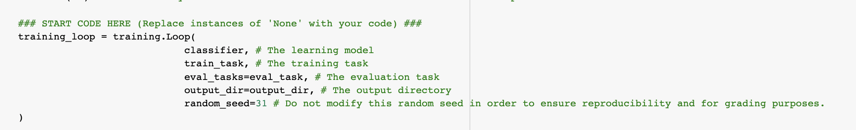
Training was done by defining a train task that had a loss function and optimizer function
Evaluation was done by defining an eval task which determine how well it did at the end using weighted category accuracy
The training loop was then defined by the model, the training task, and the evaluation task

Slide 33
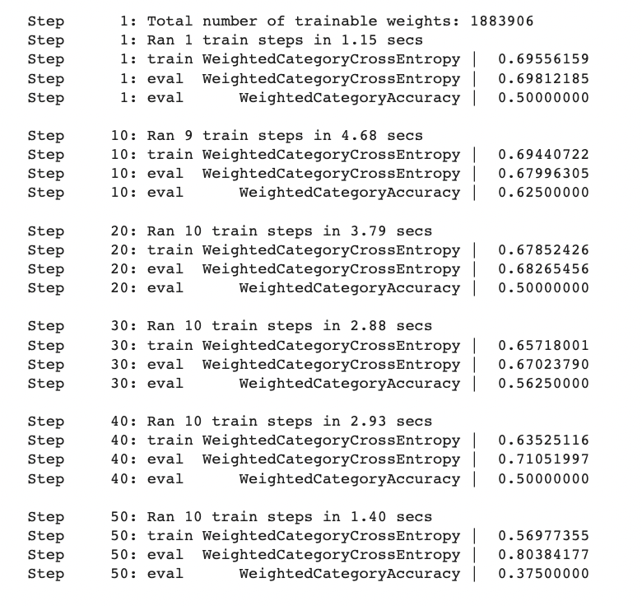
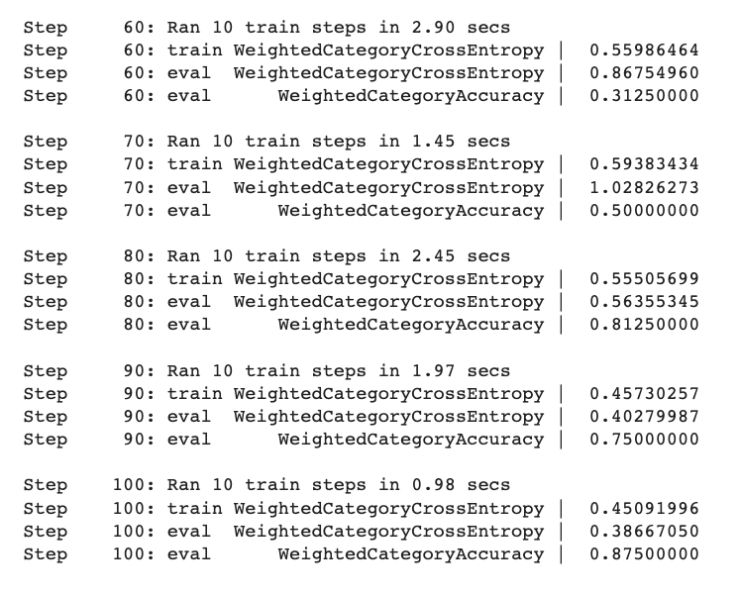
Training was performed with not the best results

Slide 34
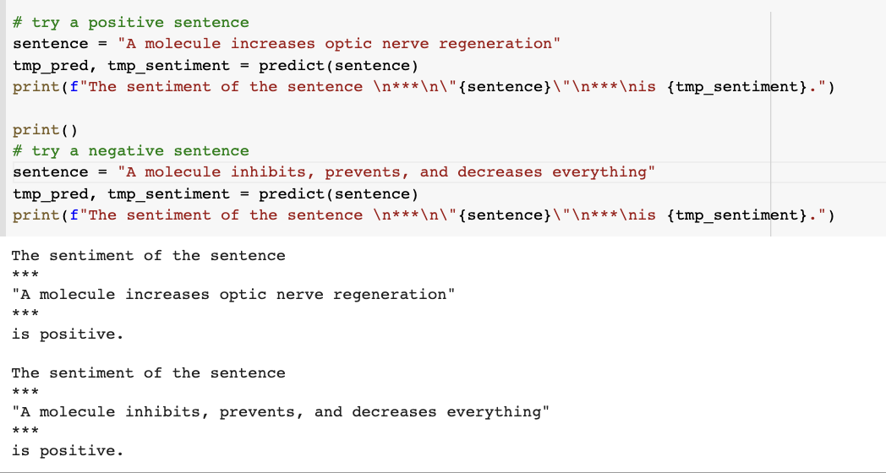
Not good results from sample sentences

Slide 35
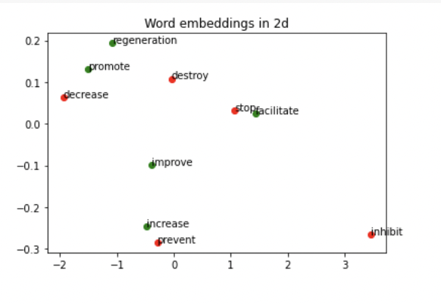
Clustering results were equally mediocre

